Slide 1



HAP 780 Final Project Survival Prediction of Oral and Pharyngeal Cancer
Qasem Dhamad

Slide 2
Background and problem description
Across the world, oral cavity and pharyngeal cancers have been prevalent types of cancers and have proved to be severe public health issues.
These anatomically related cancers are collectively the sixth most common type of cancer worldwide among men and women.
According to the American Cancer Society, in the United States, the oral cavity and pharyngeal cancers have a high incidence rate with a recent study revealing that about 54,010 new cases will be diagnosed in 2021 and 10,850 deaths due to these diseases (Cancer.net, 2021).
Overall, the lifetime chance of developing oral and oropharyngeal cancer of approximately 1 in 60 (1.7%) for males and 1 in 140 (0.71%) for females

Slide 3
The Purpose of The Study
The overall objective of this work is to develop a machine learning model for predicting the survival of oral cavity and pharyngeal cancer (OCPC) by using a data mining technique to evaluate and analyze data.

Slide 4
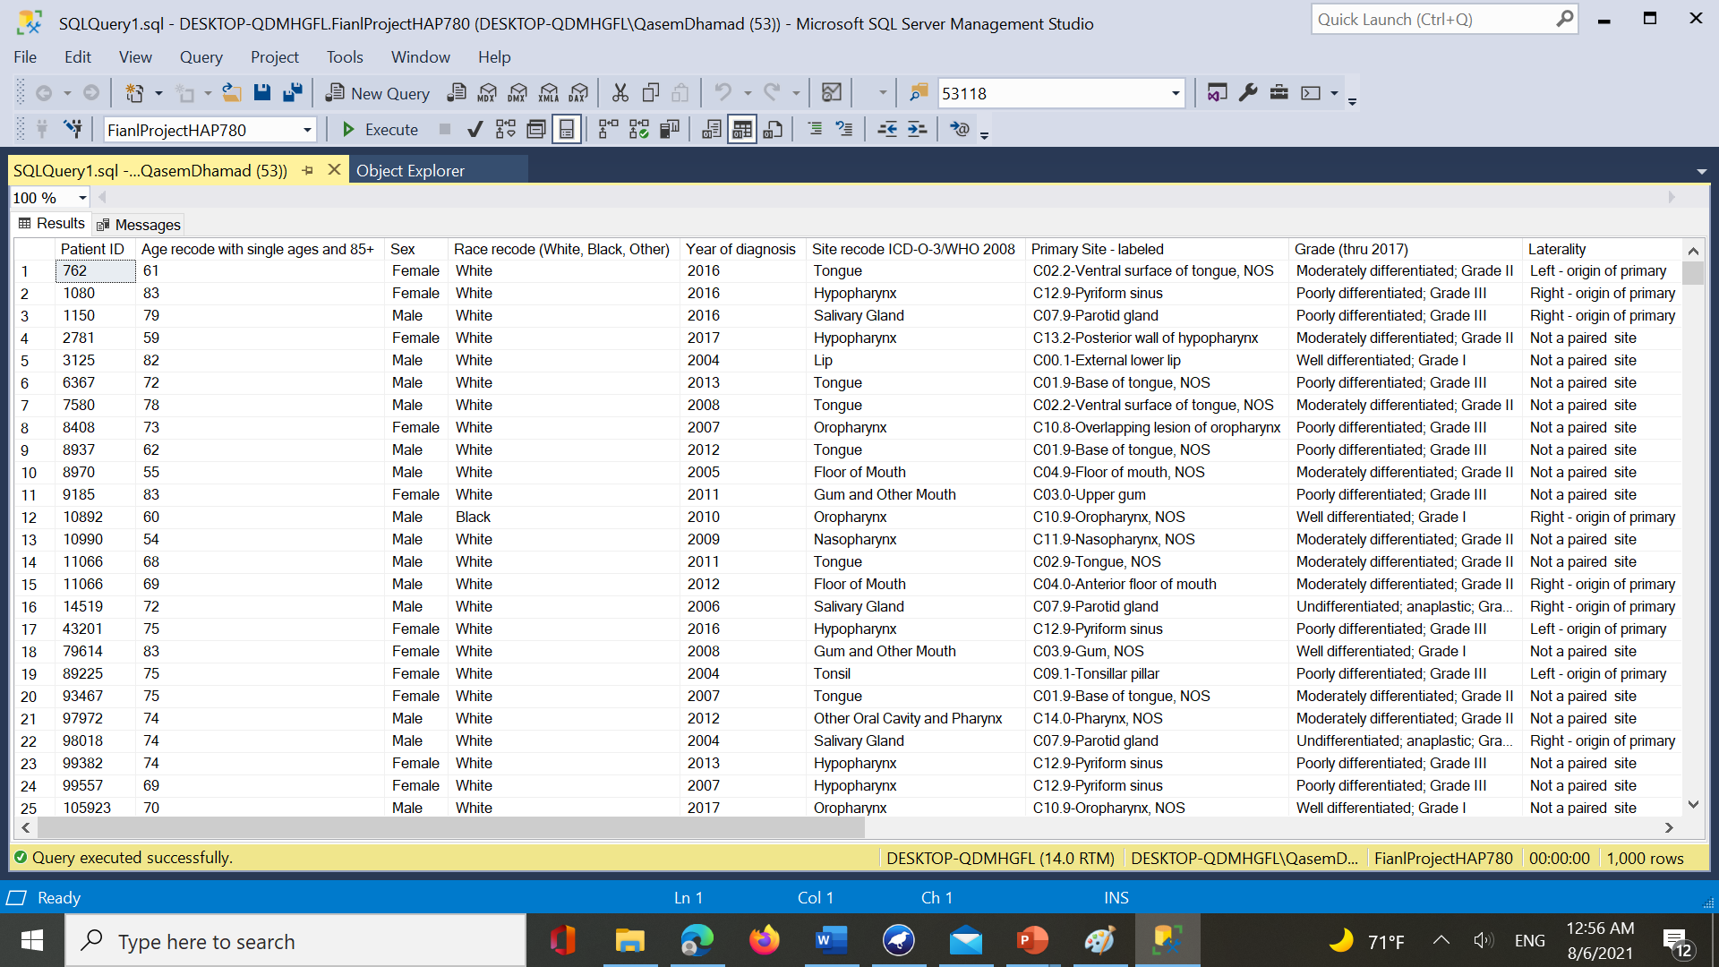
Data Source & Data Selection
The data set used in this study was extracted from Surveillance, Epidemiology, and End Results (SEER) program.
SEER 18 data from 2004 to 2017 was used to conduct the analysis. Dataset includes about 123,712 patients before the preprocessing
Oral and pharyngeal cancers were characterized by Age, Race/ethnicity, Gender, Site, Grade, Diagnostic confirmation, Histopathological Behavior, Extent of disease and Surgical treatment.

Slide 5
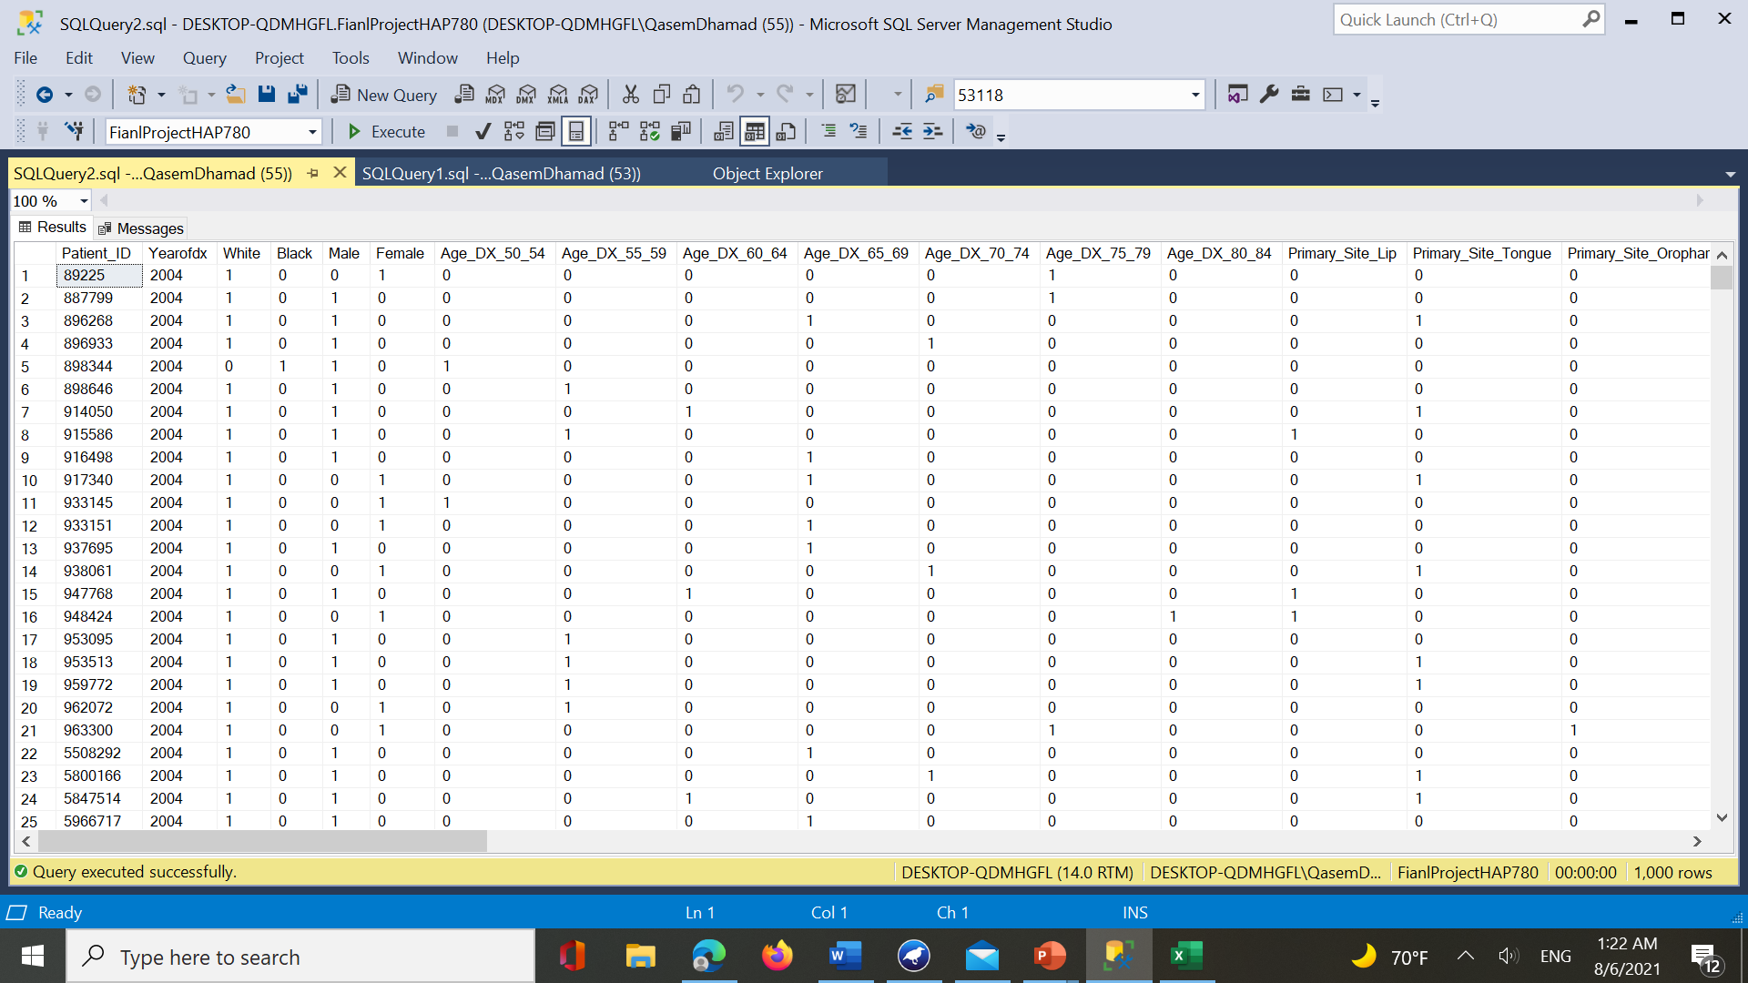
DATA PRE-PROCESSING (SQL ,Notepad++,و and Excel)

Slide 6
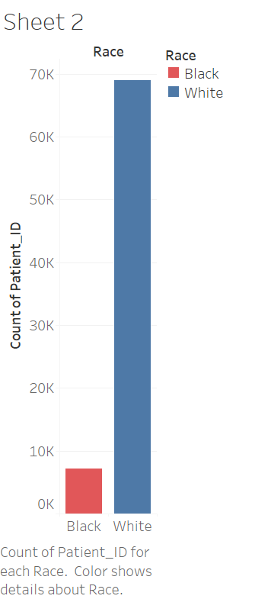
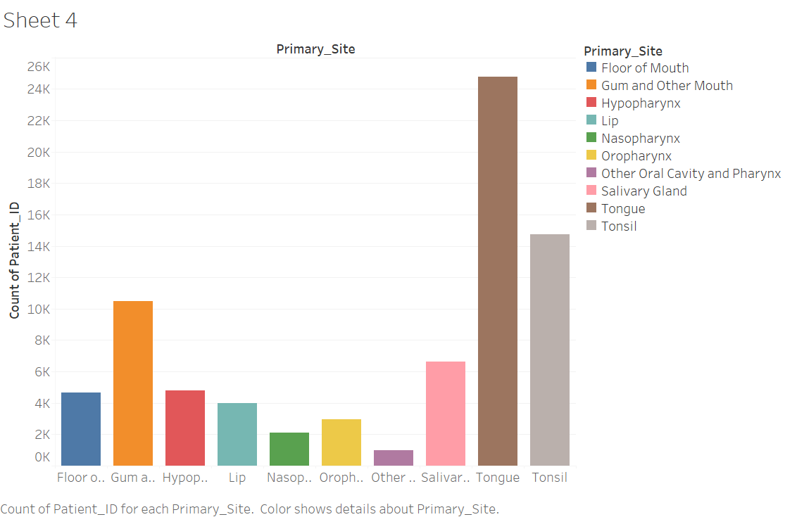
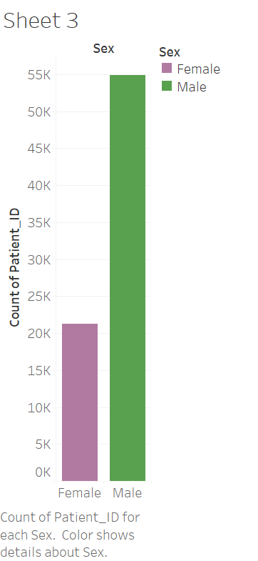
Data exploration

Slide 7

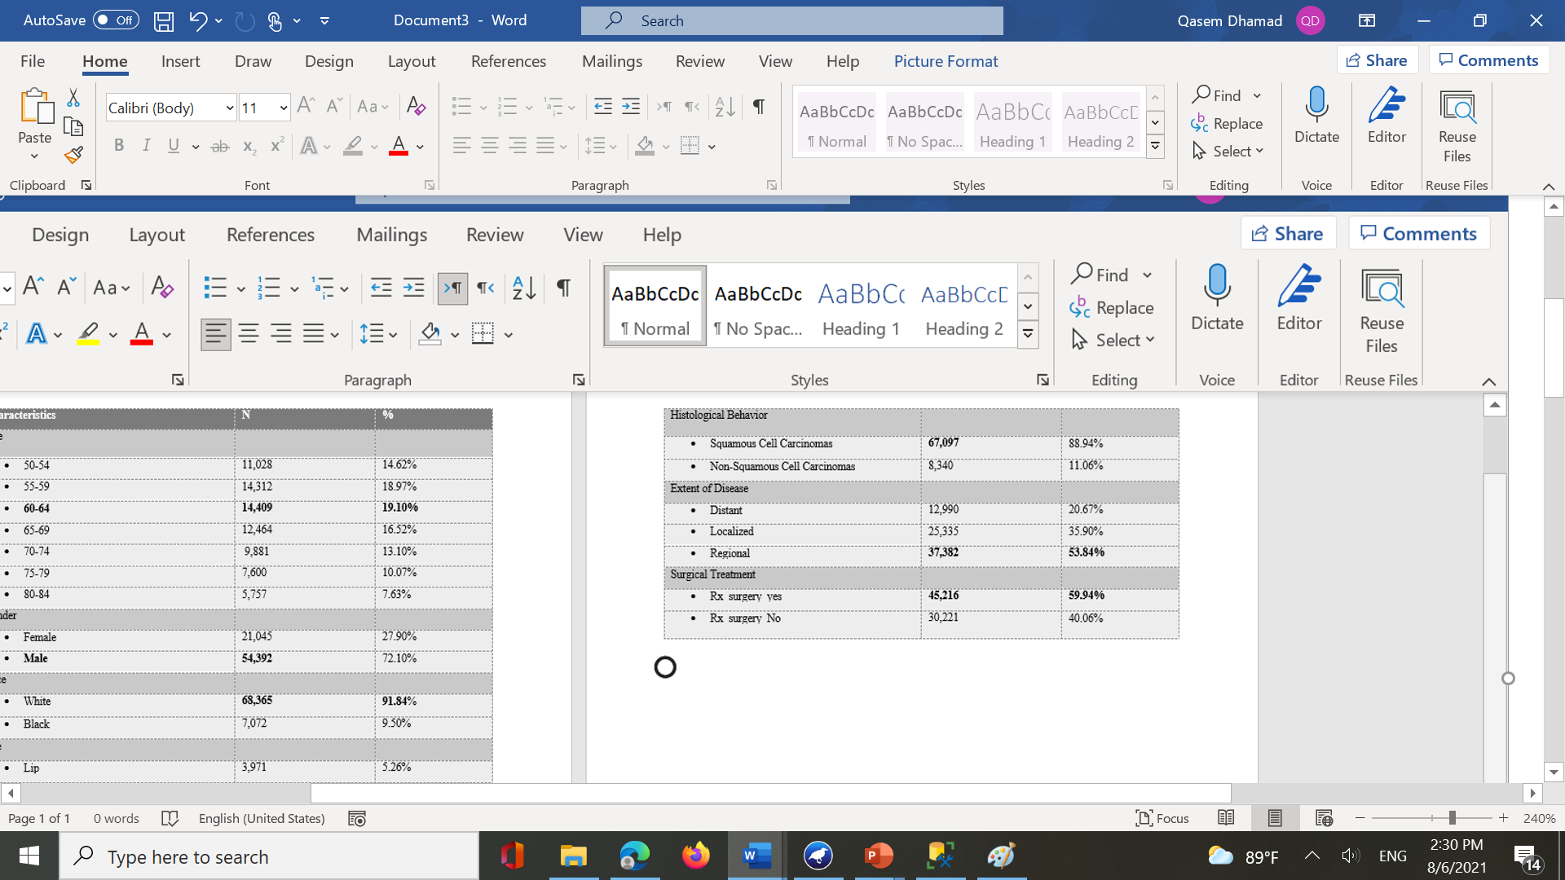
Descriptive Analysis
The table represents the descriptive analysis performed in STATA. We can observe that the highest age of the diagnosis is from 60-64 years. The most common site for oral and pharyngeal cancer is Tongue (32.85%) followed by Tonsil (19.43%). Additionally, Grade II (46.23%) (Moderately differentiated) cancers are greater in number than other grades. As predicted the Squamous cell carcinomas are almost 89% of the total oral and pharyngeal cancers. On observing the extent of disease, we find that regional and localized cancers are more common than distant. Surgical removal of the cancer is the treatment of choice for oral and pharyngeal cancers at 59% if Yes

Slide 8
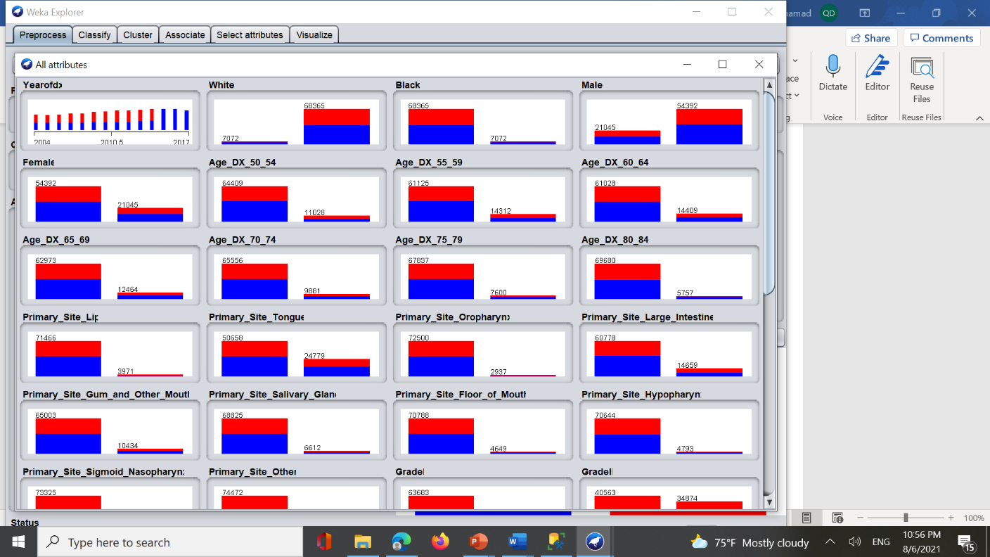
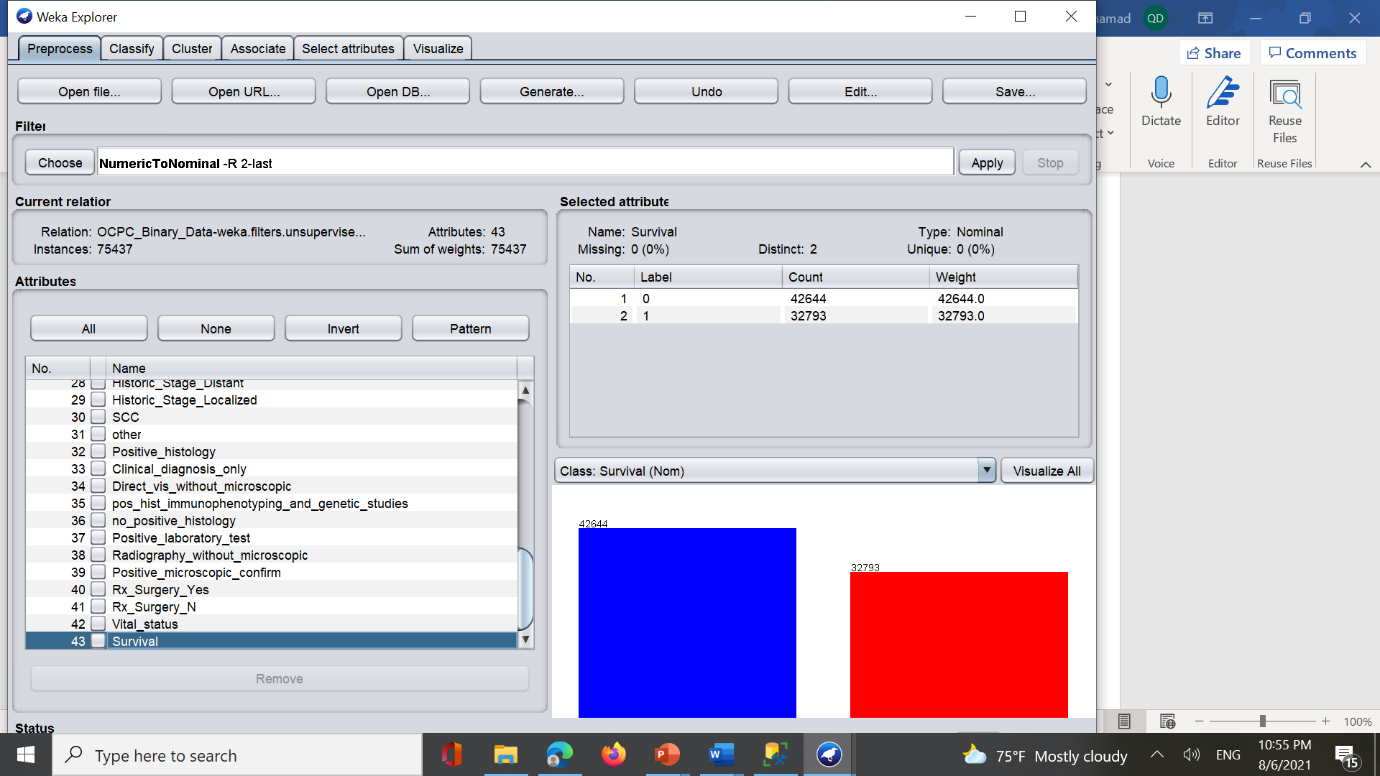
Weka Analysis
Split the data into training (66%) and testing sets (34%) and conducting experiments using the different classification schemes.

Slide 9
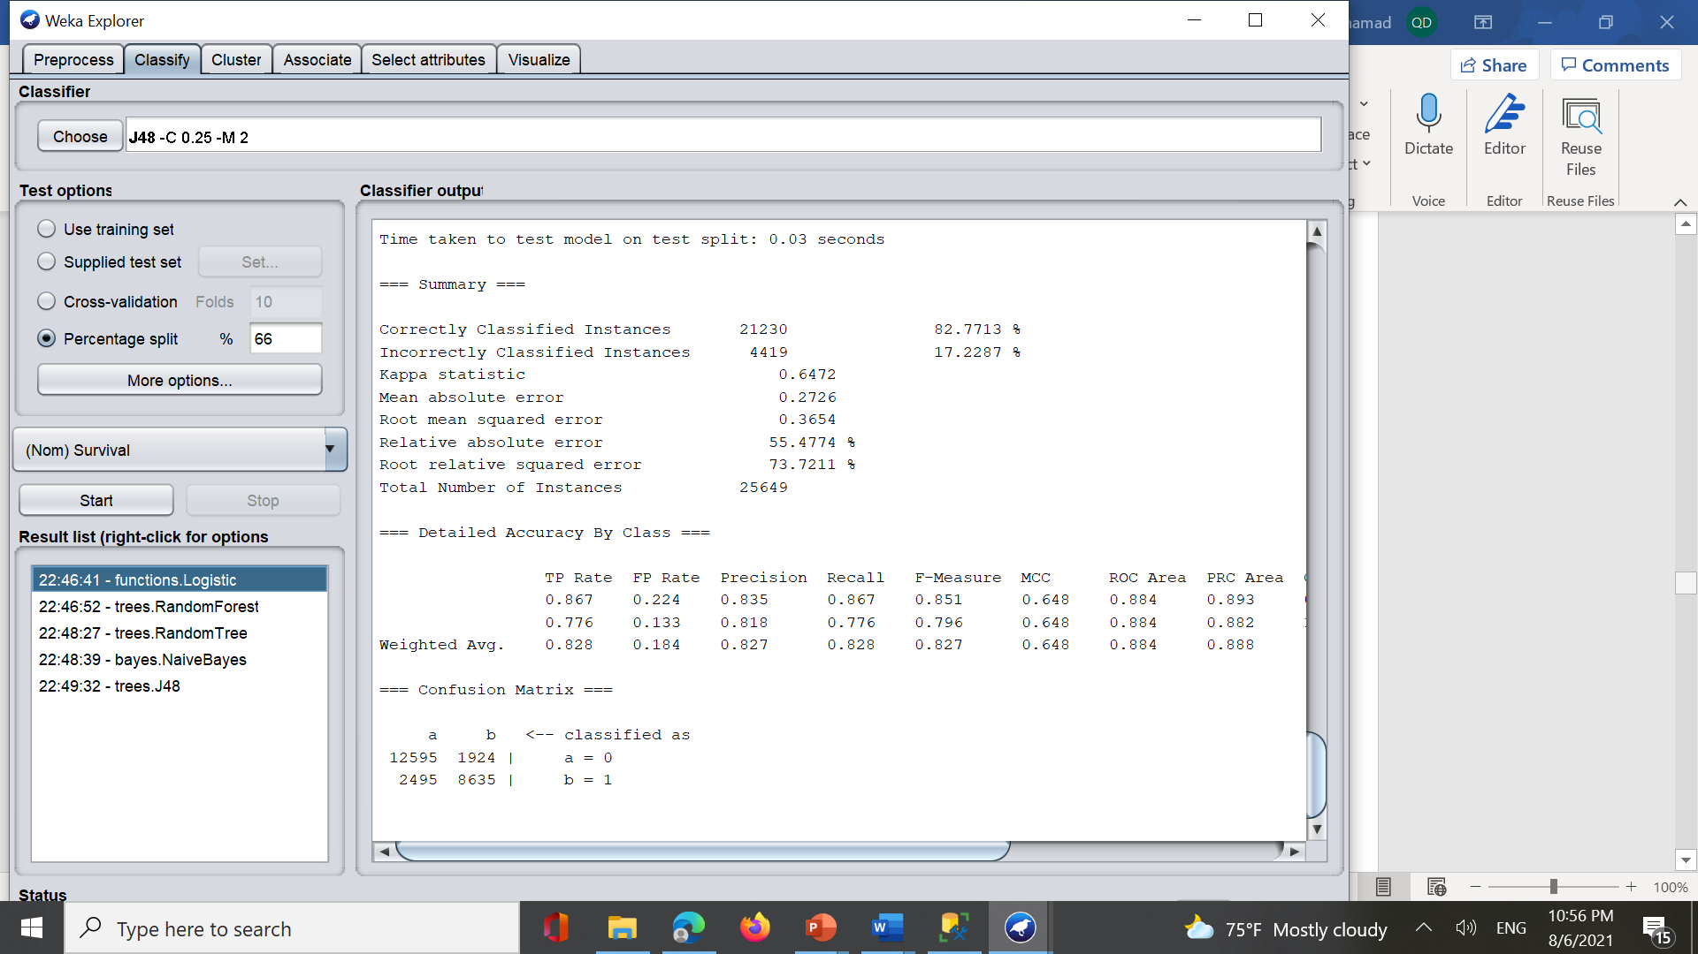
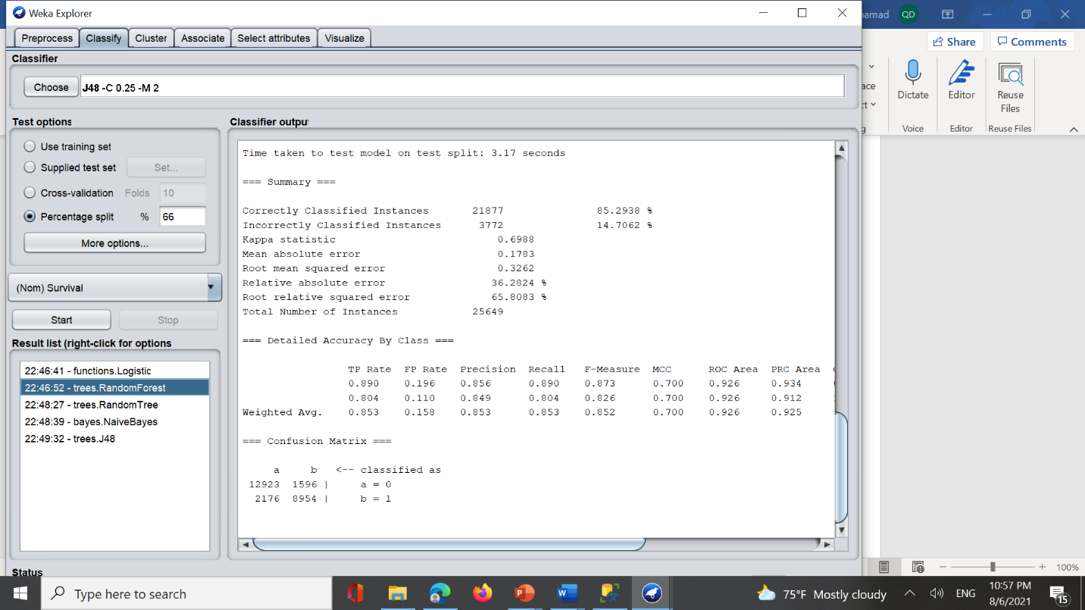
Logistic Regression and Random Forest in WEKA

Slide 10
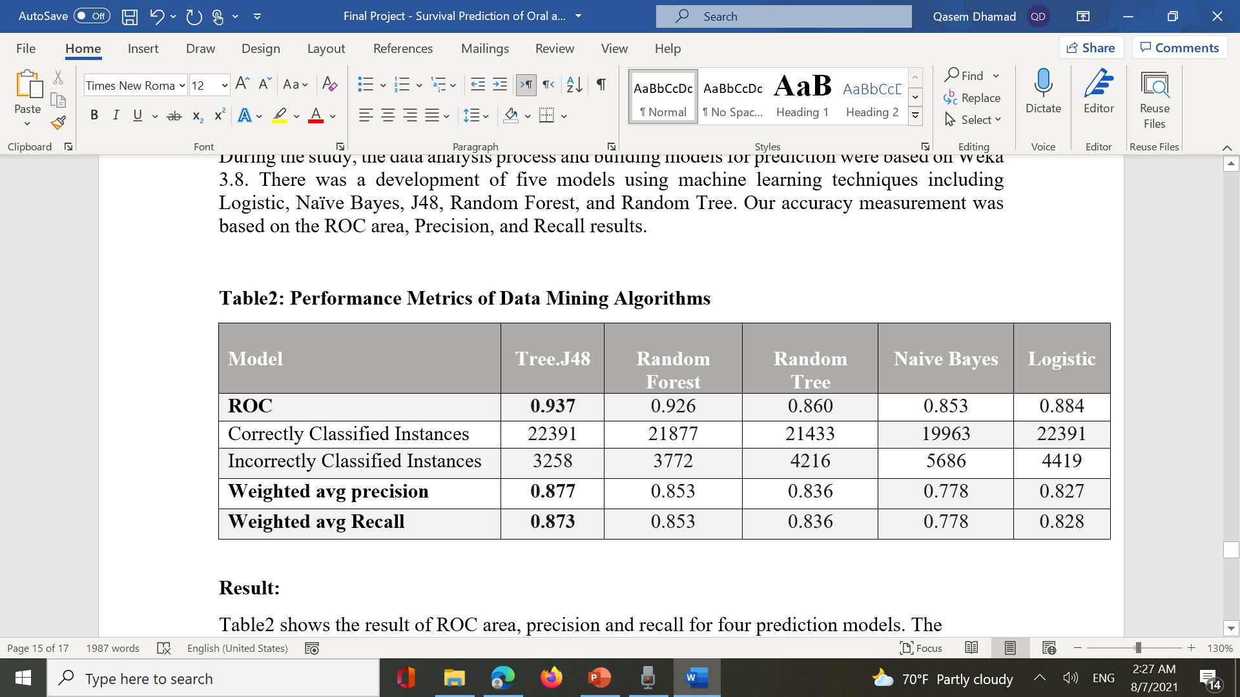
Models' accuracy (Classification Models)

Slide 11
Conclusion
The development of effective survival prediction models for oral and pharyngeal cancers (OPCs) is crucial for healthcare decision-making. This study examines the ability to predict the survival of the oral cavity and pharyngeal (OCPC) through classification models based on machine learning. Logistic Regression, J48, Random Forest, Naïve Bayes, and Random Tree are the five machine learning classifiers that were applied on a set of 75,473 records to achieve this goal. From this study work, it has been experimentally proven that the J48 provides better result at 0.937 as compared to other models. There are many data mining systems in hospitals designed to predict survival of patient cancer. However, this model can be applied in hospitals to give assistance in making decisions and delivering high-quality health care by healthcare professionals, and decision-makers.

Slide 12
What have I learned from this project?
Through this project, I learned about the SEER program and its structure, data pre-processing, attribute selection, implementation of machine learning algorithms, and how to read the results in Weka software.

Slide 13
References
Oral and Oropharyngeal cancer - Introduction. Cancer.Net. (2021, May 5). https://www.cancer.net/cancer-types/oral-and-oropharyngeal-cancer/introduction
Mayo Foundation for Medical Education and Research. (2020, October 20). Mouth cancer. Mayo Clinic. https://www.mayoclinic.org/diseases-conditions/mouth-cancer/symptoms-causes/syc-20350997
What are oral cavity AND Oropharyngeal Cancers? American Cancer Society.https://www.cancer.org/cancer/oral-cavity-and-oropharyngeal-cancer/about/what-is-oral-cavity-cancer.html
Oral cancer facts. The Oral Cancer Foundation. https://oralcancerfoundation.org/facts/
Pelucchi, C., Gallus, S., Garavello, W., Bosetti, C., & La Vecchia, C. (2006). Cancer risk associated with alcohol and tobacco use: Focus on upper aero-digestive tract and liver. Alcohol research & health: the journal of the National Institute on Alcohol Abuse and Alcoholism. https://www.ncbi.nlm.nih.gov/pmc/articles/PMC6527045
Cancer of the oral cavity and Pharynx - Cancer Stat Facts. SEER. https://seer.cancer.gov/statfacts/html/oralcav.html
“Hpv Infection.” Mayo Clinic, Mayo Foundation for Medical Education and Research, 15 May 2021, www.mayoclinic.org/diseases-conditions/hpv-infection/symptoms-causes/syc-20351596

Slide 14
Thank You

